Slide 1

Bringing People into AR
Huynh Bao Trung Nguyen, Andreas Stiller, Luke Gavin

Slide 2
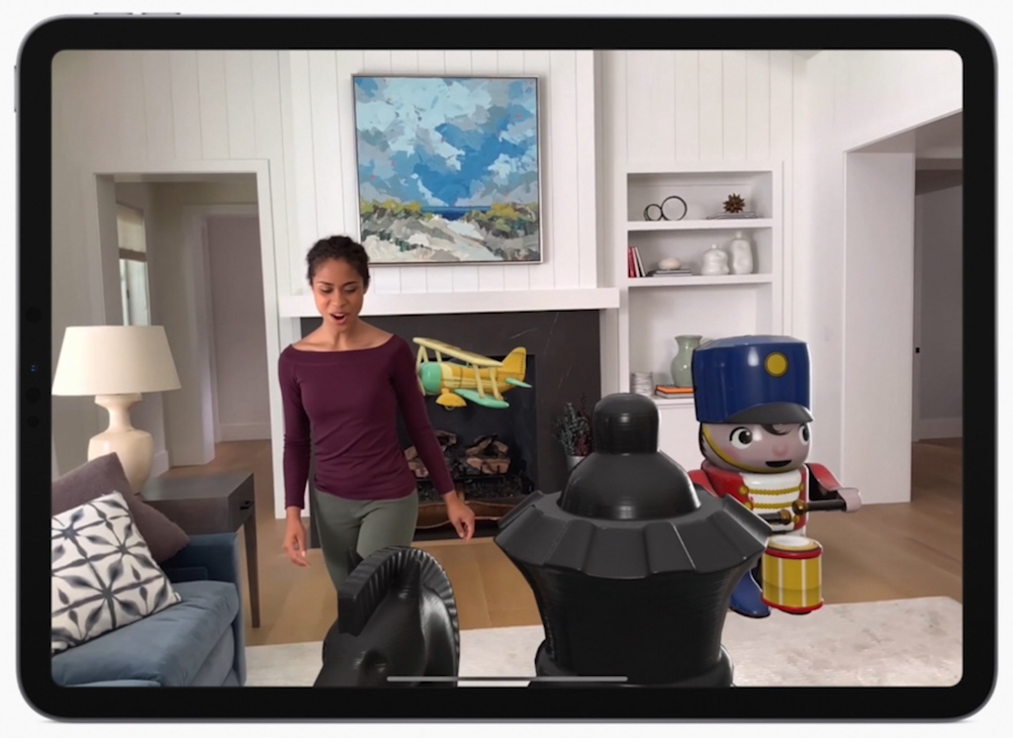
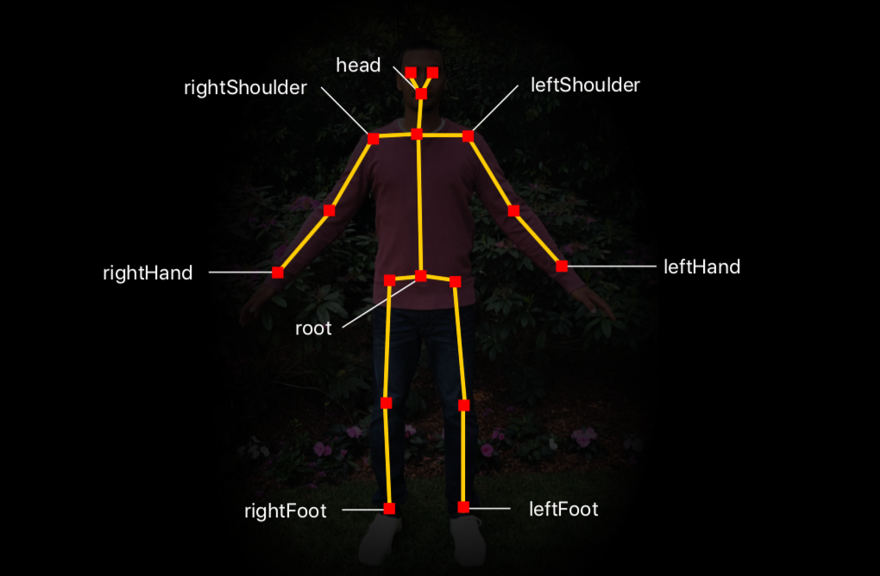
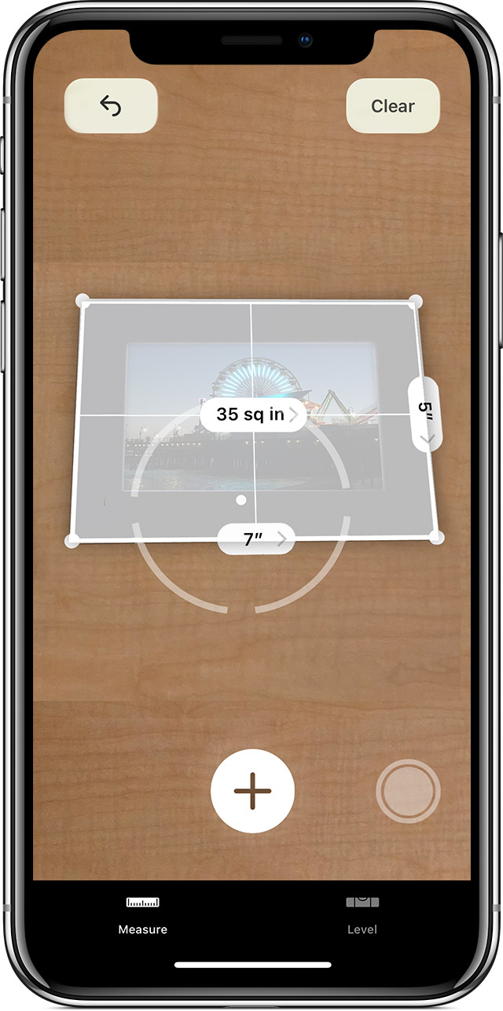
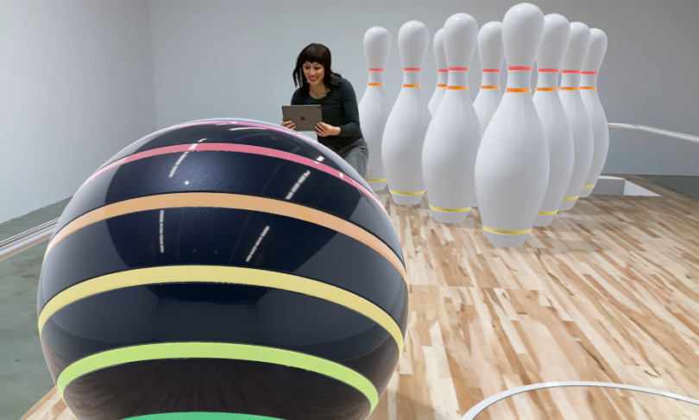
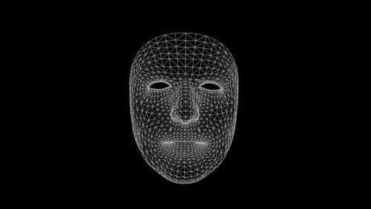
ARKit

Slide 3
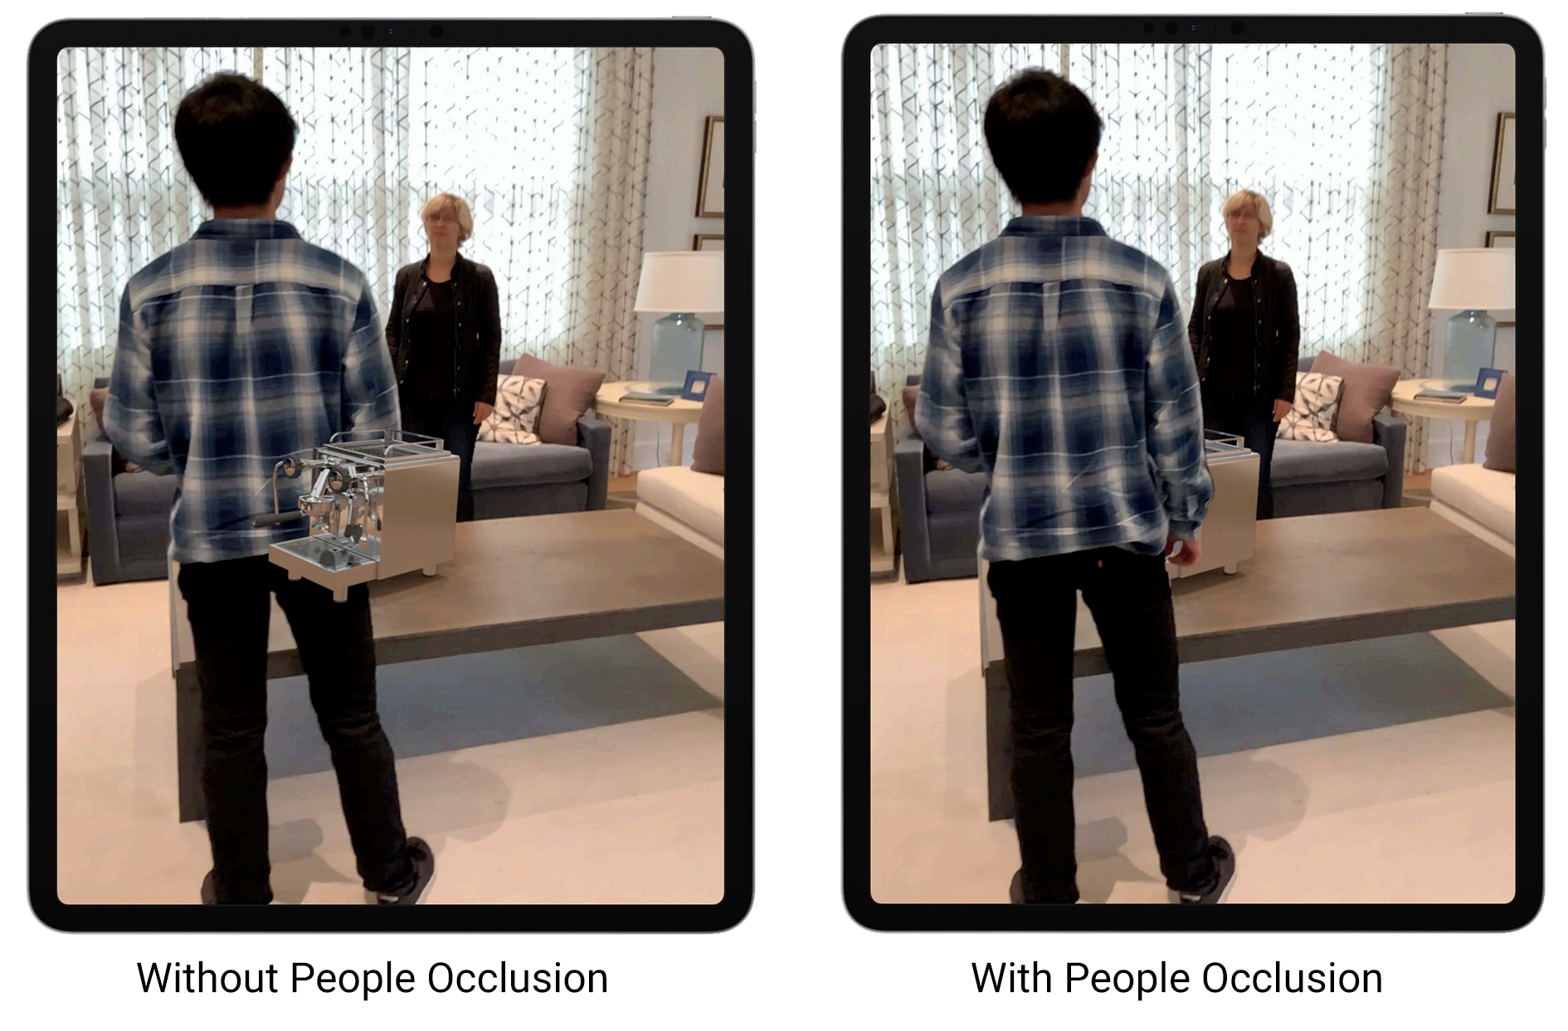
People Occlusion
Depth-ordering problem

Slide 4
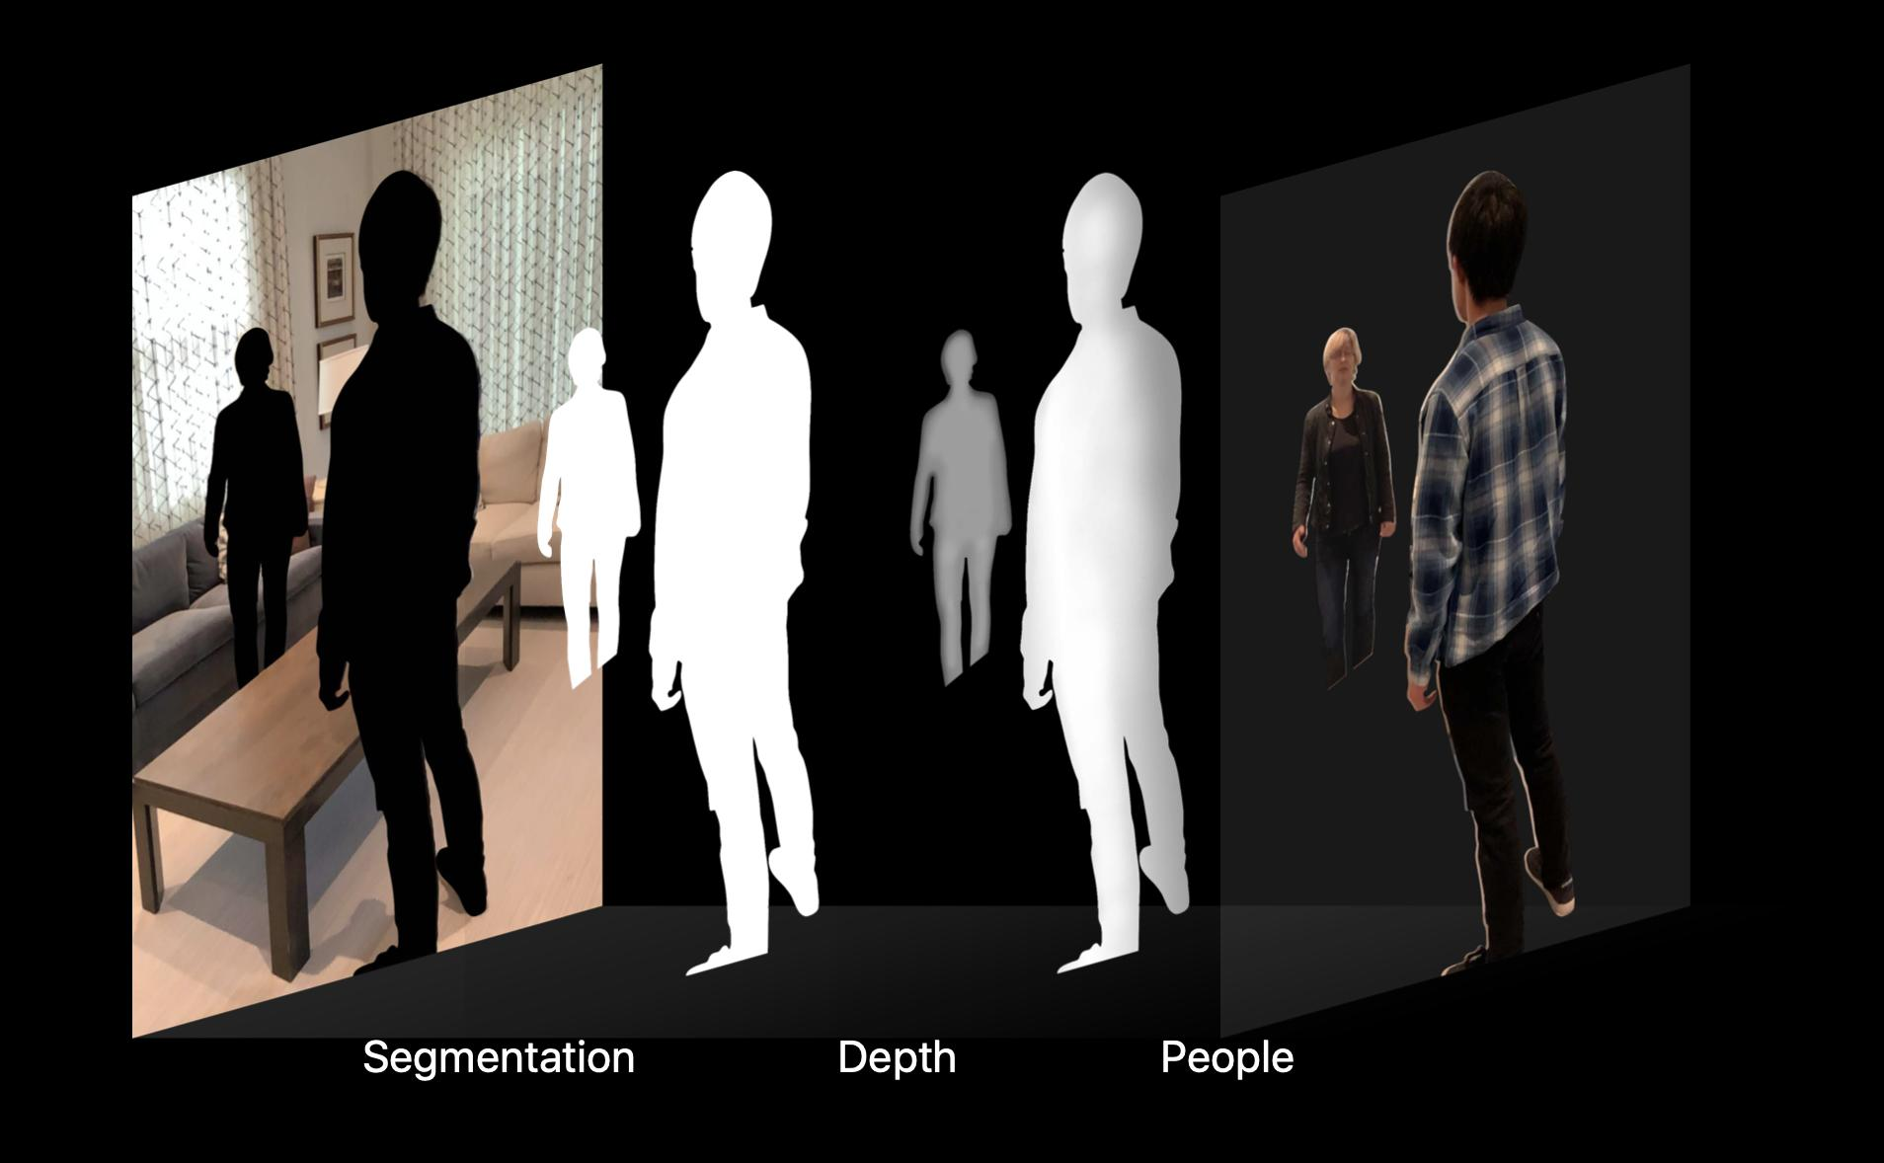

Slide 5

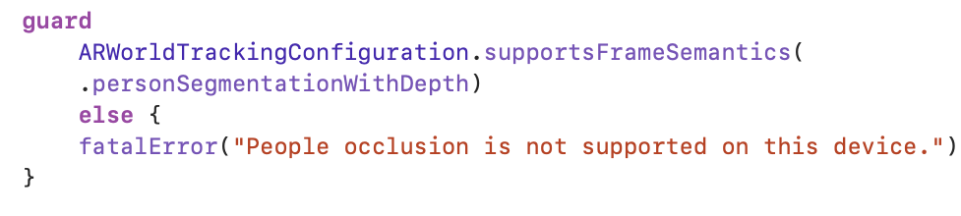


People Occlusion in RealityKit
Verify Device Support for People Occlusion
Enable People Occlusion

Slide 6
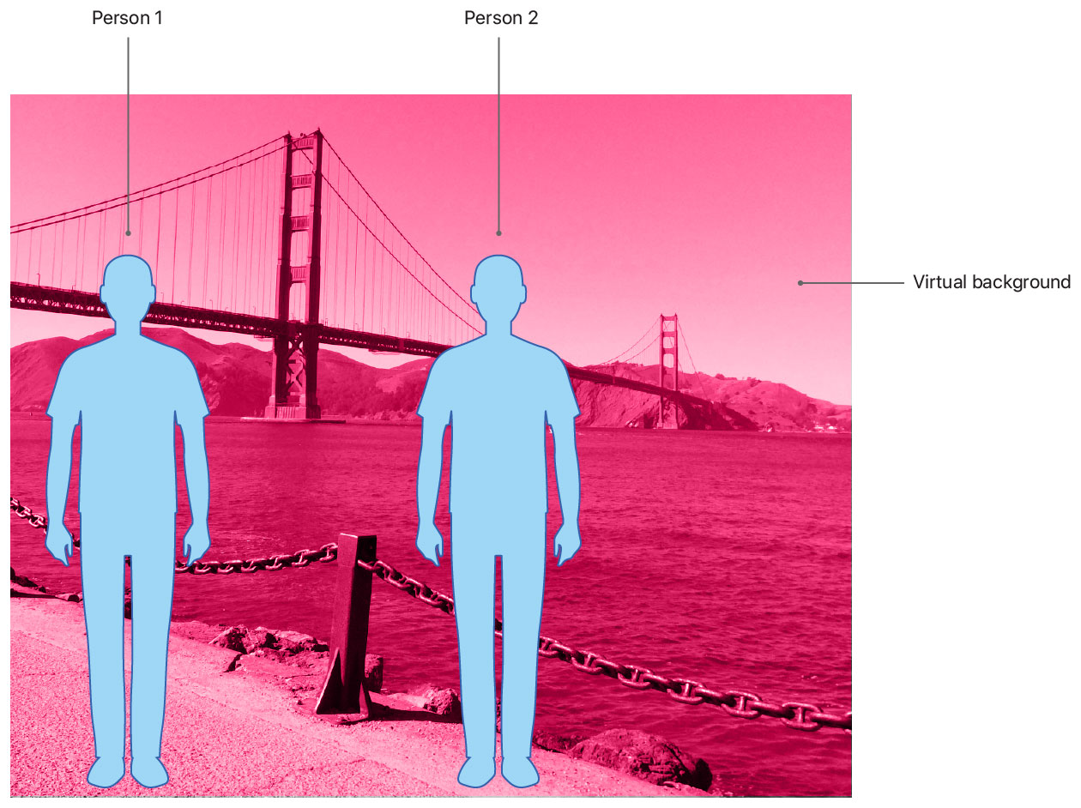
Disable People Occlusion
Always occlude persons:
personSegmentation
Occlude persons depending on depth:
personSegmentationWithDepth

Slide 7


SceneKit
Backwards compatible with ARSCNView
Transparency Problems
Metal
Custom composition
Integrate into your own renderer

Slide 8
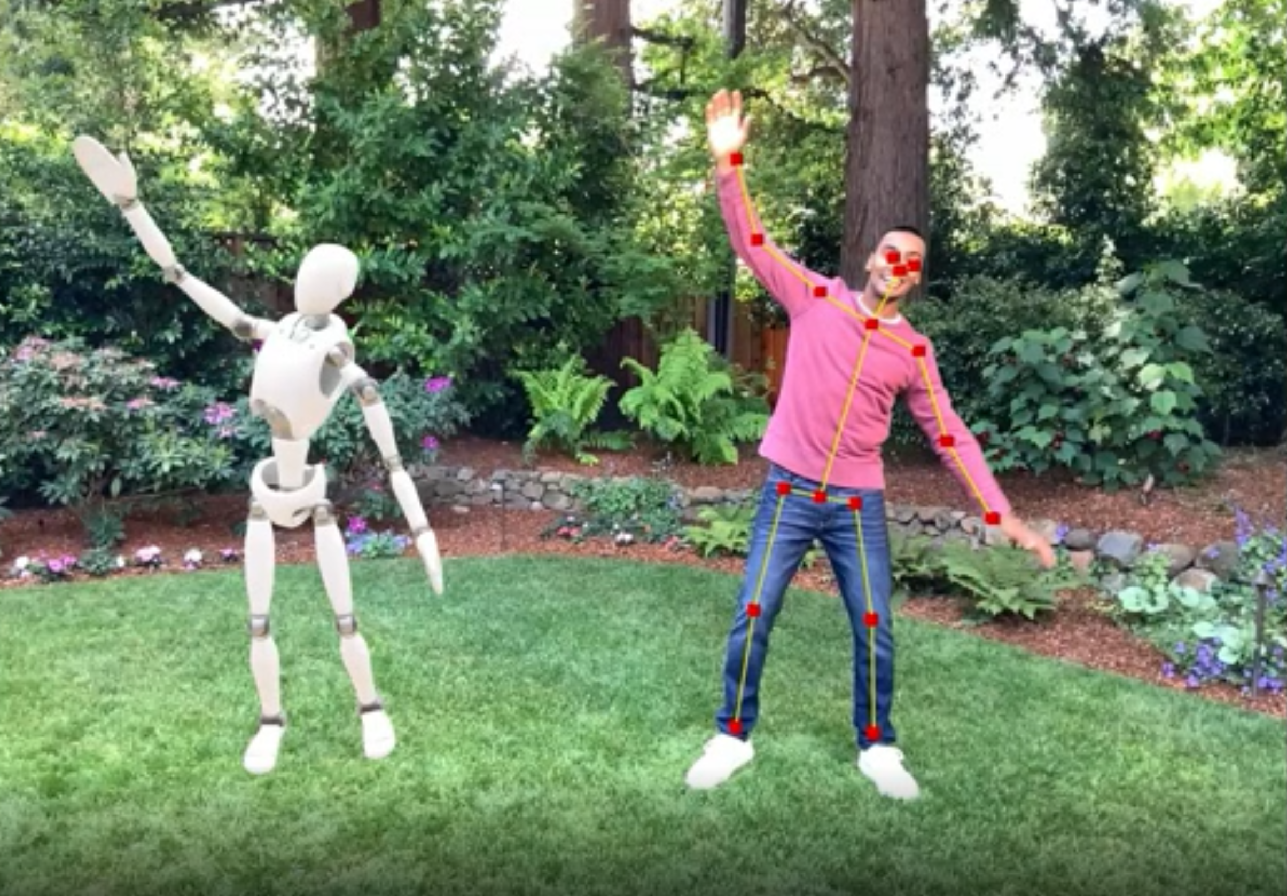
Body
Tracking

Slide 9
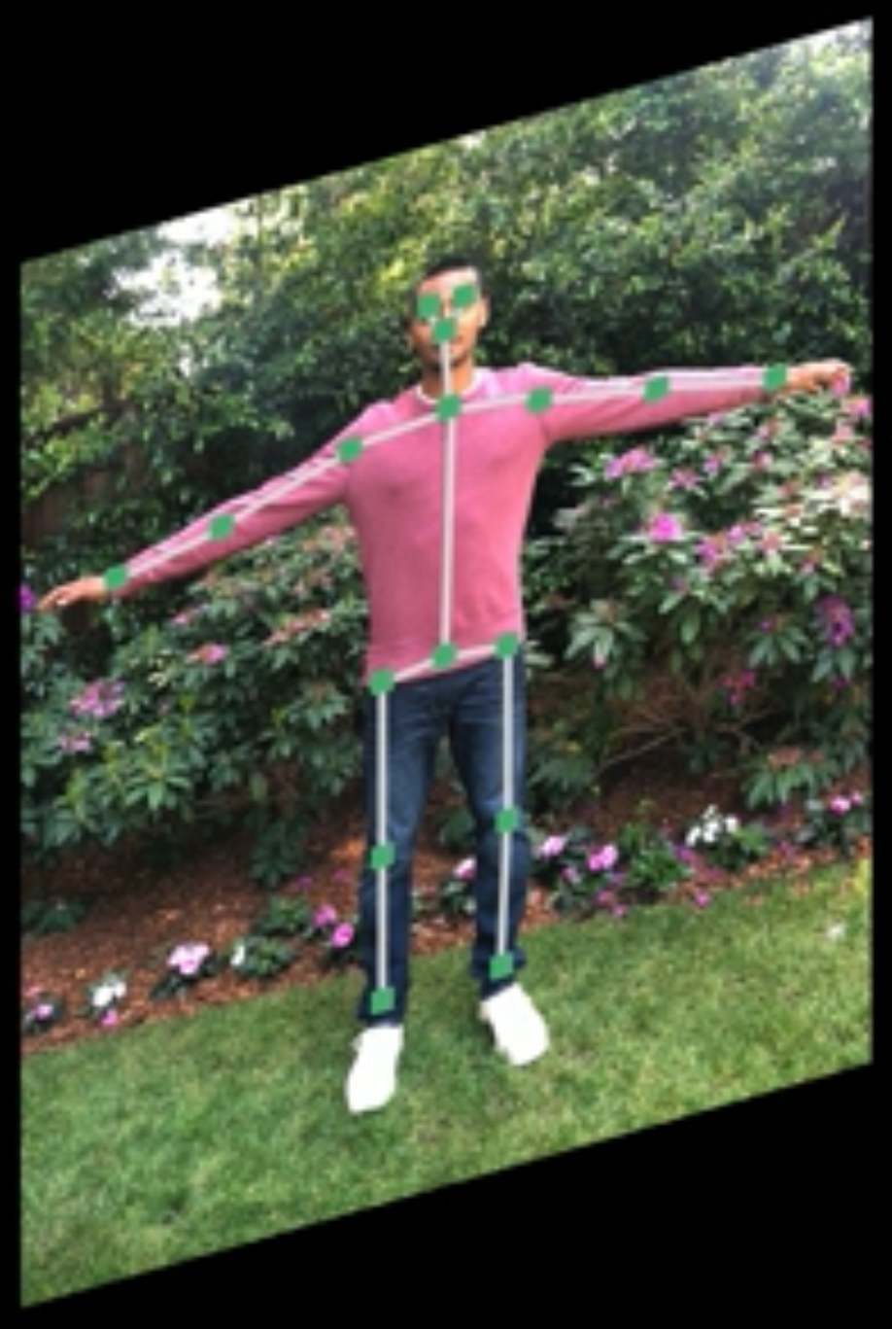
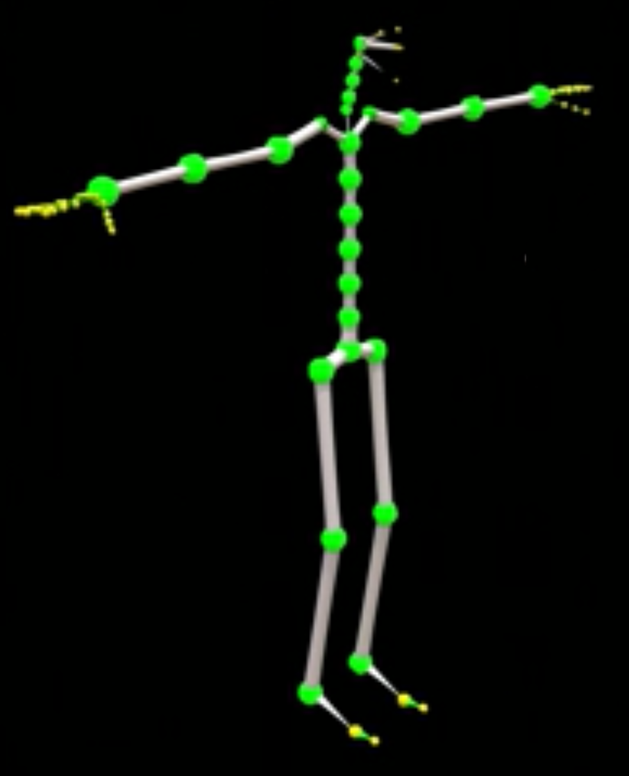
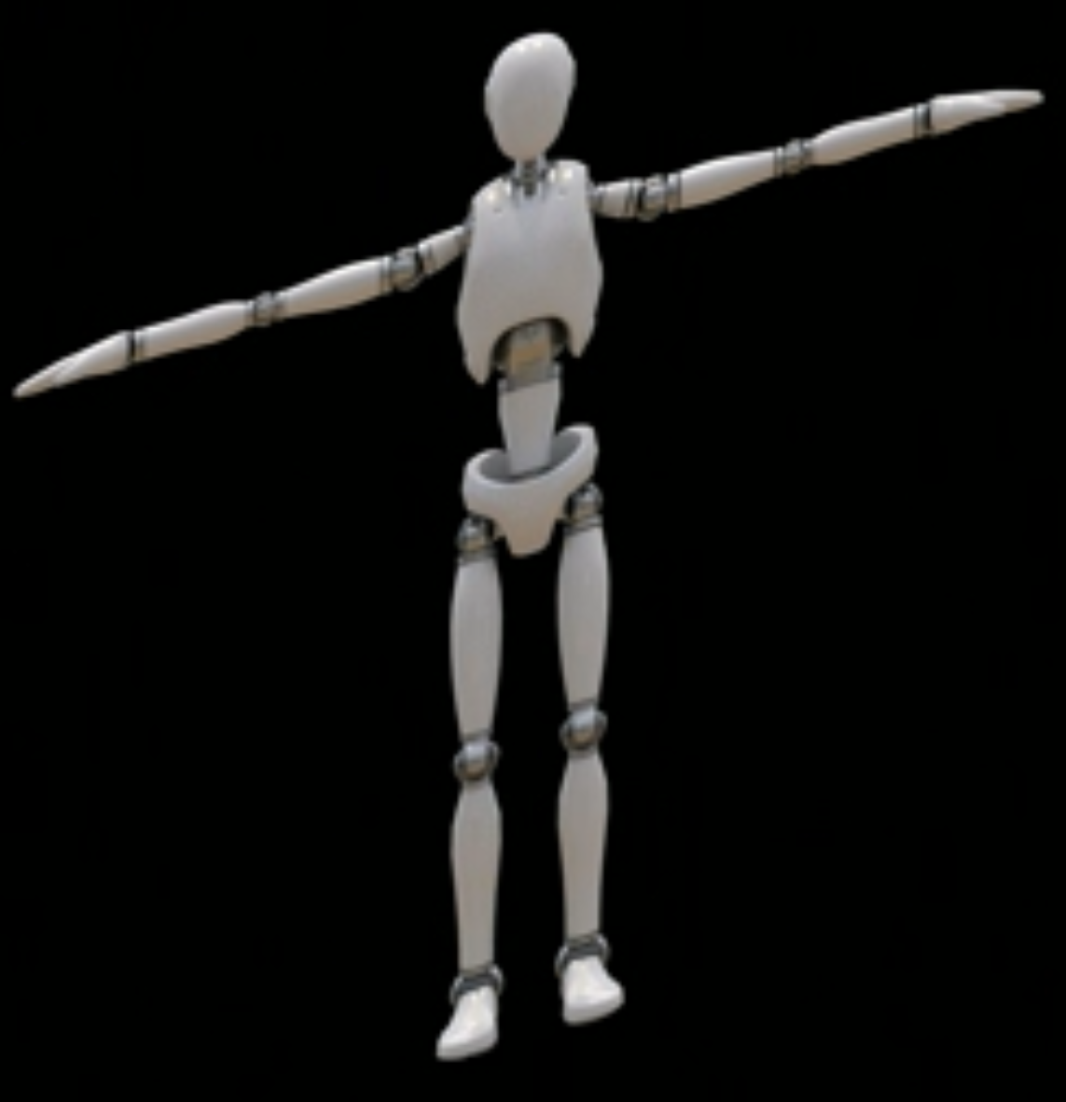

Slide 10
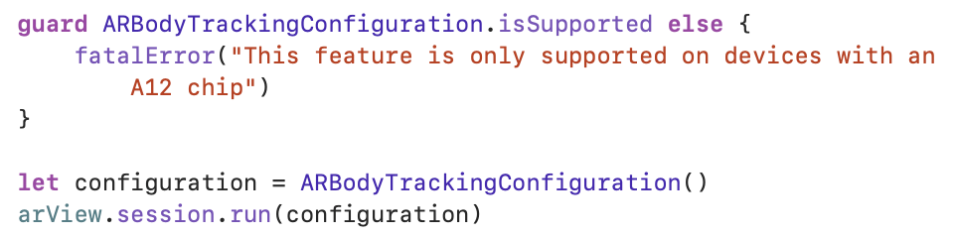
Motion Capture in RealityKit
Verify Device Support for Body Tracking

Slide 11
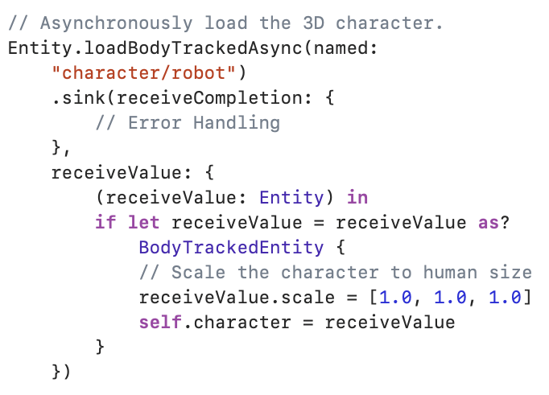
Load Rigged Mesh and Tracked Person

Slide 12

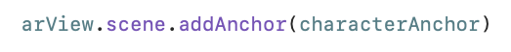
Get location where you want to put your character
Add the character to that location

Slide 13
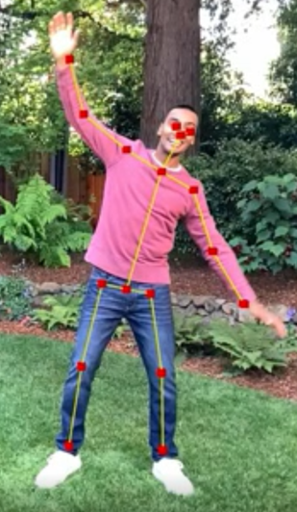
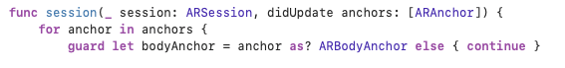
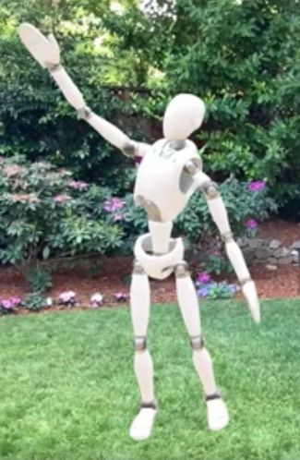
ARSessionDelegate to get ARBodyAnchor
BodyTrackedEntity

Slide 14
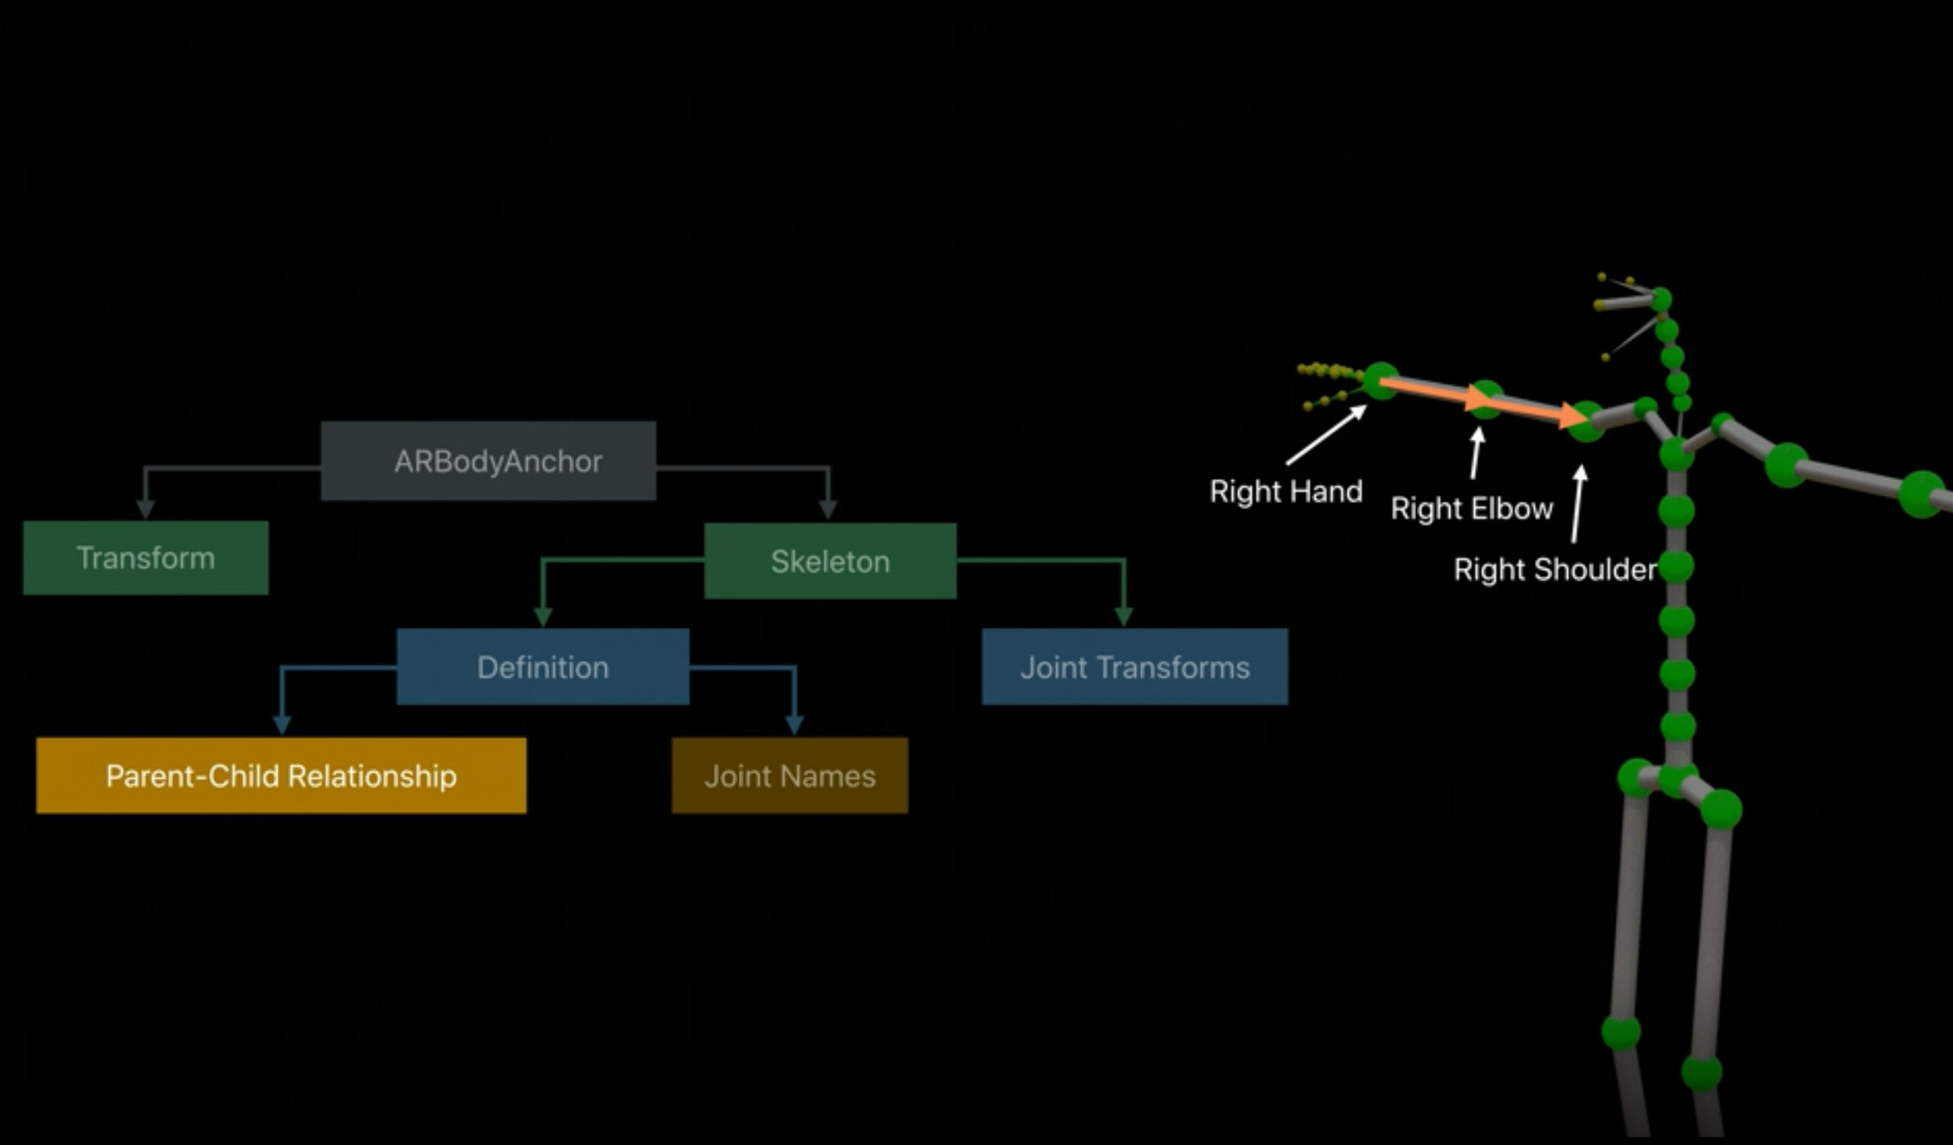

Slide 15
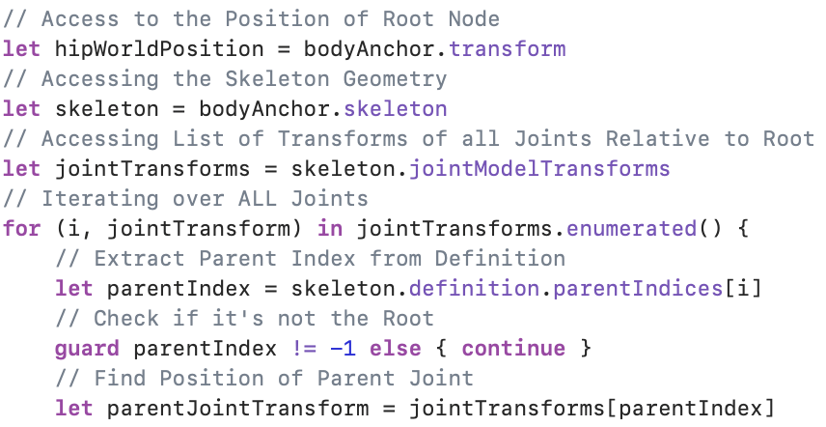
Extracting Data from 3D Skeleton

Slide 16
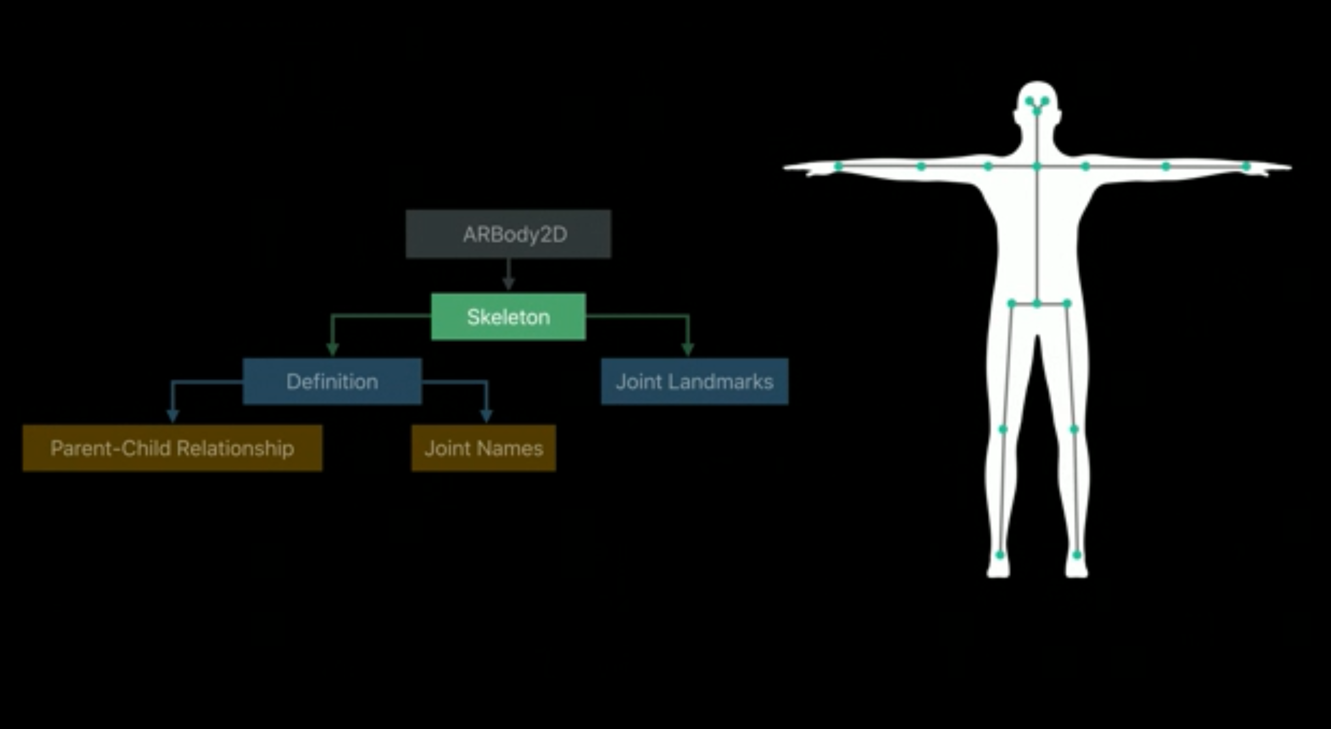

Slide 17
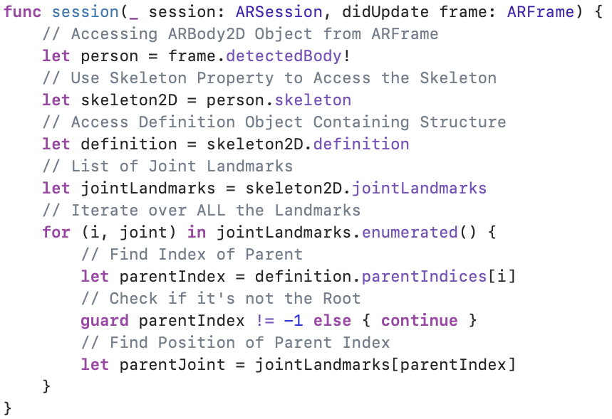
Extracting Data from 2D Skeleton

Slide 18
Demo

Slide 19
Thank you for your attention
Any Questions?

